Slide 1
Contents
Glossary or Formula Page
Page
Date
Description
Word
Description
2
3

Slide 2
Tasks
24
7
30
Topic
Essential Question
Questions
Notes
Summary
8
9

Slide 3
Parts of a Circle and Circumference
EQ – How do I label a circle and find the circumference?
Mrs Stretch
Year 8

Slide 4
Learning Intentions
Students will be able to
Label the parts of a circle
Find the circumference of a circle

Slide 5
24
7
30
Parts of Circle and Circumference
Date
EQ – How do I label a circle and find the circumference?
The circumference of a circle is the boundary of the circle.
The perimeter of a circle
A line drawn from the centre of a circle to the circumference is the radius.
Every radius in a circle is equal in length.

Slide 6

24
7
30
Parts of Circle and Circumference
Date
EQ – How do I label a circle and find the circumference?
A line drawn through the centre from one side of a circle to its opposite side is called the diameter.
It is double the length of the radius.

Slide 7


Slide 8
Practice

Slide 9



24
7
30
Parts of Circle and Circumference
Date
EQ – How do I label a circle and find the circumference?
Circumference = π x diameter
How do I find the circumference of a full circle?
$$C=πd$$
Since the diameter is twice the length of the radius, it can also be found as:
Circumference = π x 2 x radius
$$C=2πr$$
*remember that multiplication can be done in any order*

Slide 10
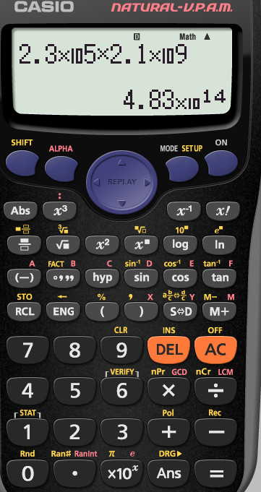
Press “shift” first
Then press the x10 button to get pi

Slide 11
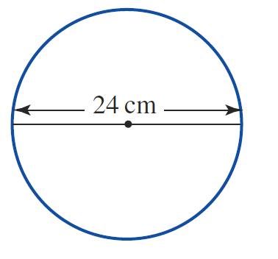
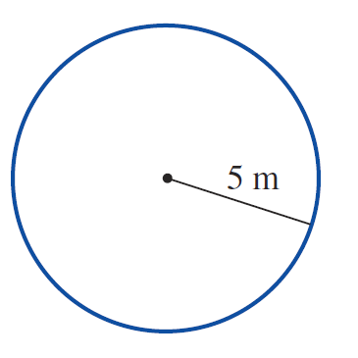
Practice

Slide 12
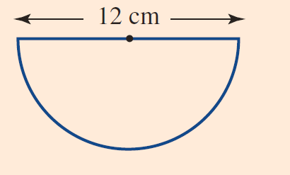
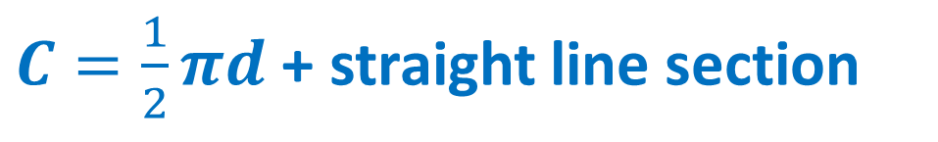
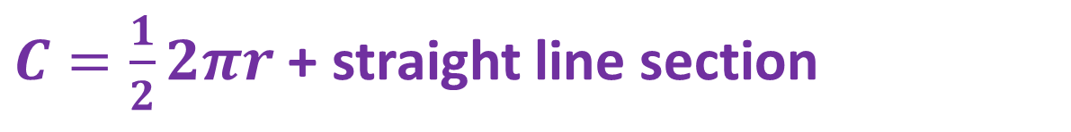
24
7
30
Parts of Circle and Circumference
Date
EQ – How do I label a circle and find the circumference?
How do I find the circumference of a semi circle?
$C=\frac{1}{2}πd$ + straight line section
$C=\frac{1}{2}2πr$ + straight line section

Slide 13
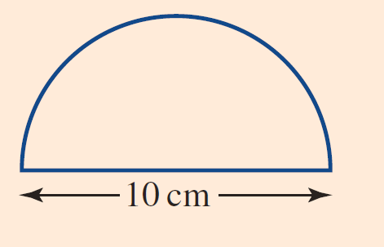
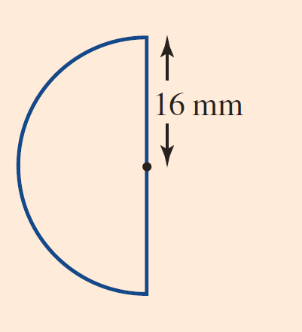
Practice

Slide 14
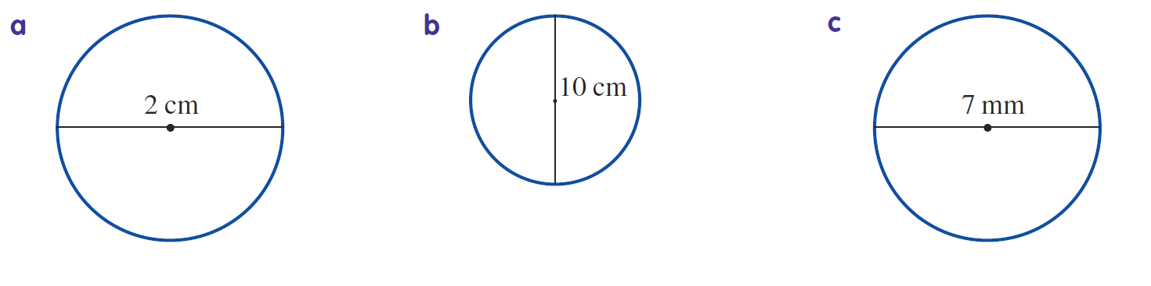
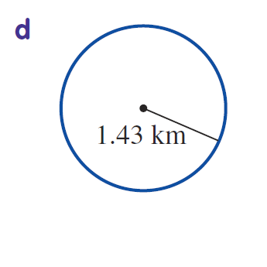
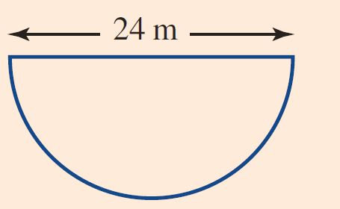
Task

